Slide 1
Prototype and Flow
2014-09-17

Slide 2



Material Control
Material Request View
Material Request
Material Request Detail
Procure Need from ProTOM
Procurement View
Material View
warehouse
Unassigend Procure Request Tab
Create Reuqest List
Modification
To Procure Tab
On Build Site Tab
Material Overview
Borrow Part
Change
Procure Detail
Release Part
Procured Tab
Delivery Control

Slide 3


Delivery Control
Procurement
Delivery View
Assign Delivery Controller View
External Tab
Internal Tab
Supplier Tab
France & Sweden
PO Tab
Or
External Part Detail
Internal Part Detail
Project Tab
USA
Report View
Warehouse
Report

Slide 4





Warehouse Setup
Warehouse
Warehouse Setup
Material
Receive View
Pick View
Ship View
To Receive
Not Received
Pick Tab
Ship Tab
Add Information
Mobile UI
Mobile UI
Dispatch Note
Store View
Inventory View
Move Part
Mobile UI
To Store
Store
Inventory
Scrap Part
Mobile UI
Deviation

Slide 5
Material Request

Slide 6
Material Request Overview
GLORIA
Material Request
Material Request
CRUD Material Request
Send Material Request
Procurement

Slide 7
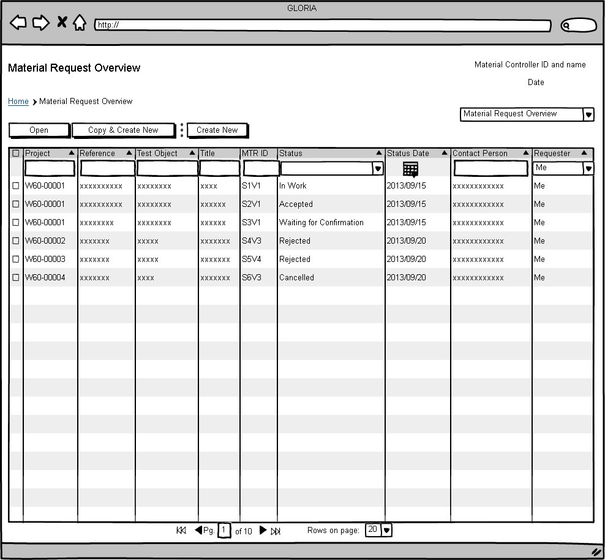

Slide 8
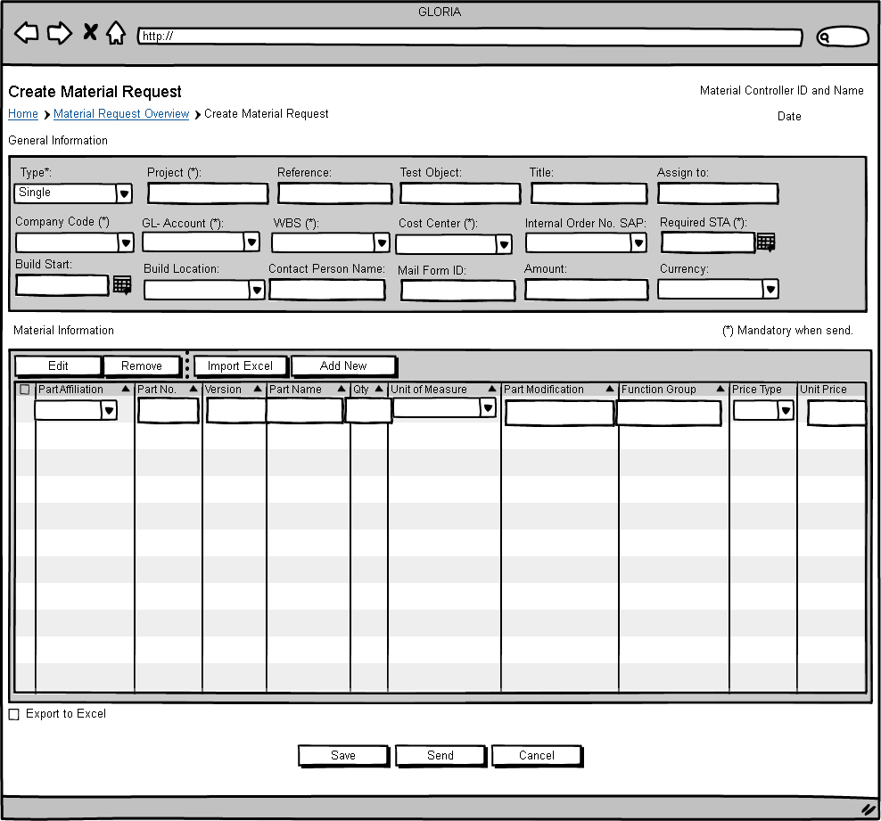

Slide 9
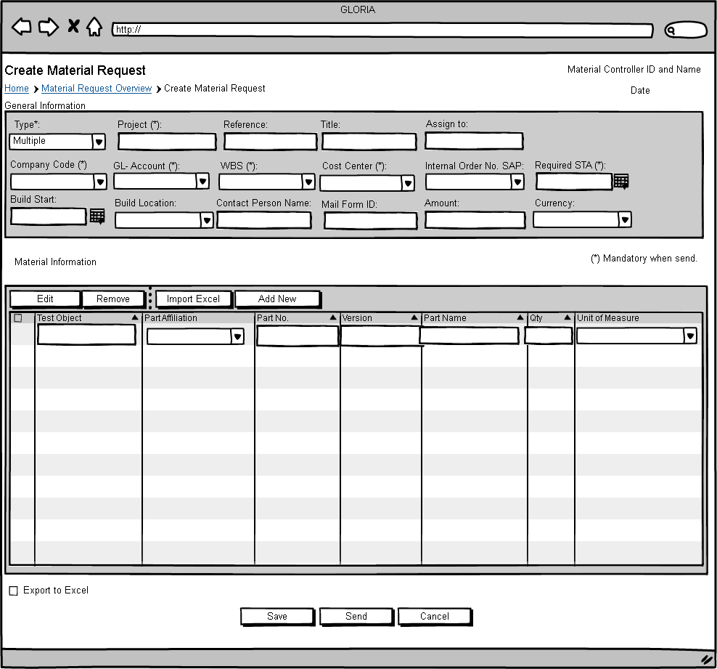

Slide 10
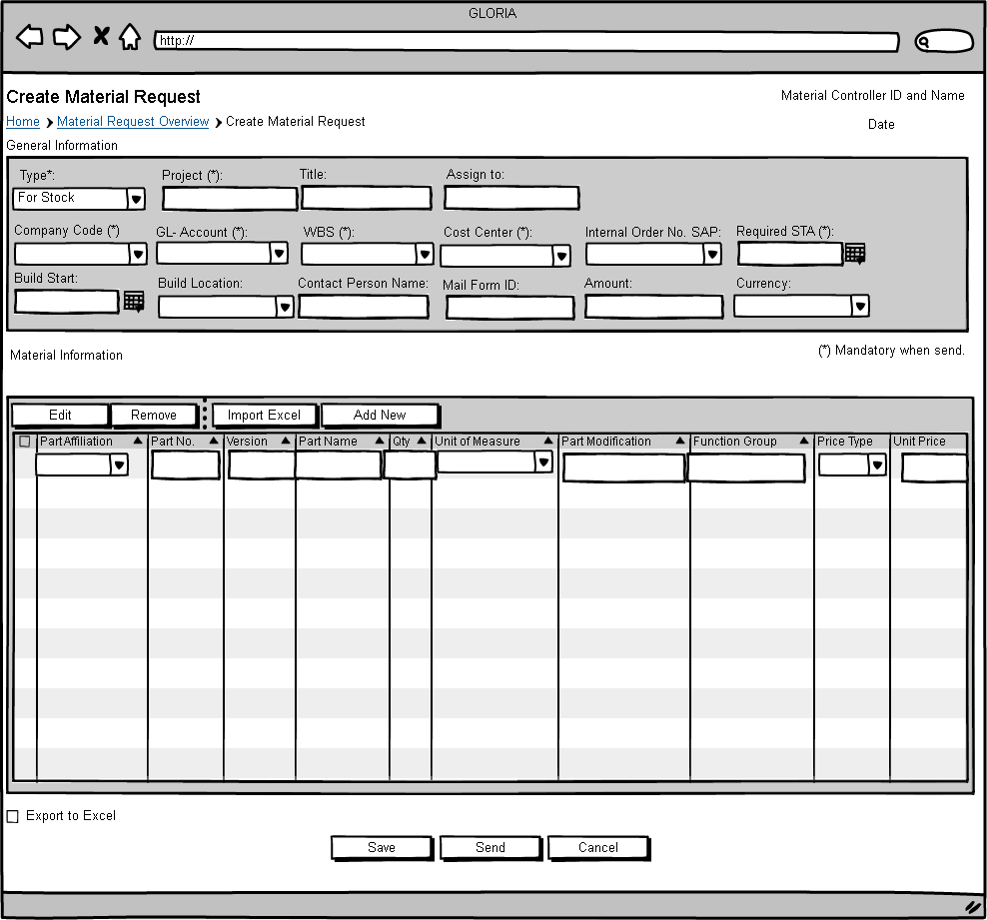

Slide 11
Procurement

Slide 12
ProTOM
Procure Request
Procurement
Unassigned Procure Request Tab
GLORIA
Material Request
To Procure Tab
Modification
Tab
On Build Site
Tab
Procured
Tab
Change
Tab
Procure Part:
External
Internal
From stock
External+ From Stock
Internal + From Stock
Modify the Part Information:
Change kola part no. to the procurement part no.
Delegate the responisibilty
To the build
site.
Check & Search the procured part.
Check & Search the changes related to the MTR, Accept/ Reject the Changes

Slide 13
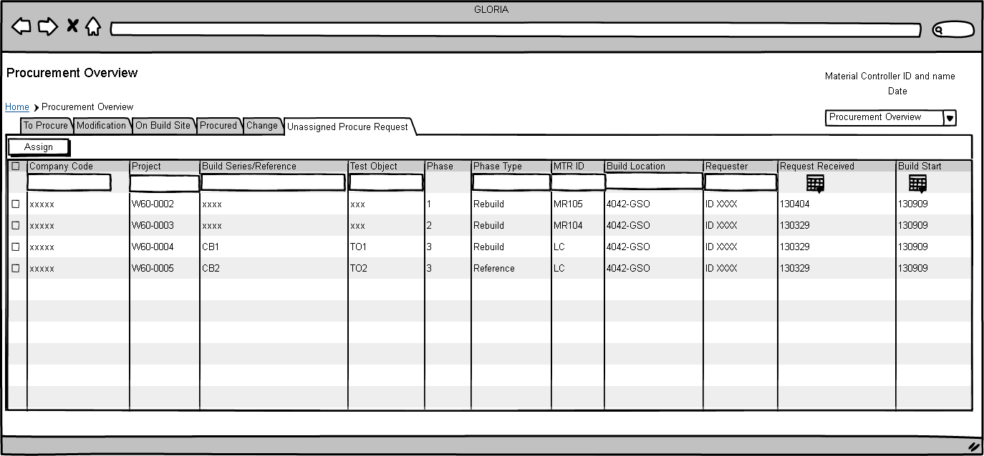

Slide 14
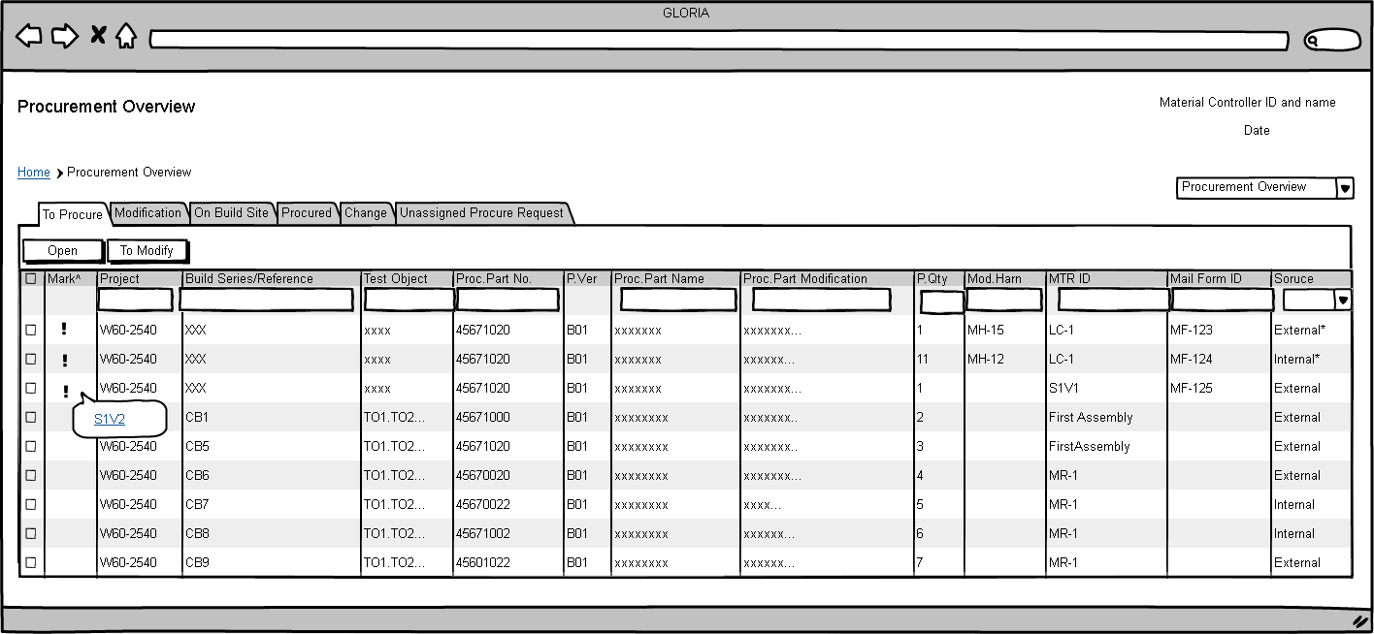

Slide 15
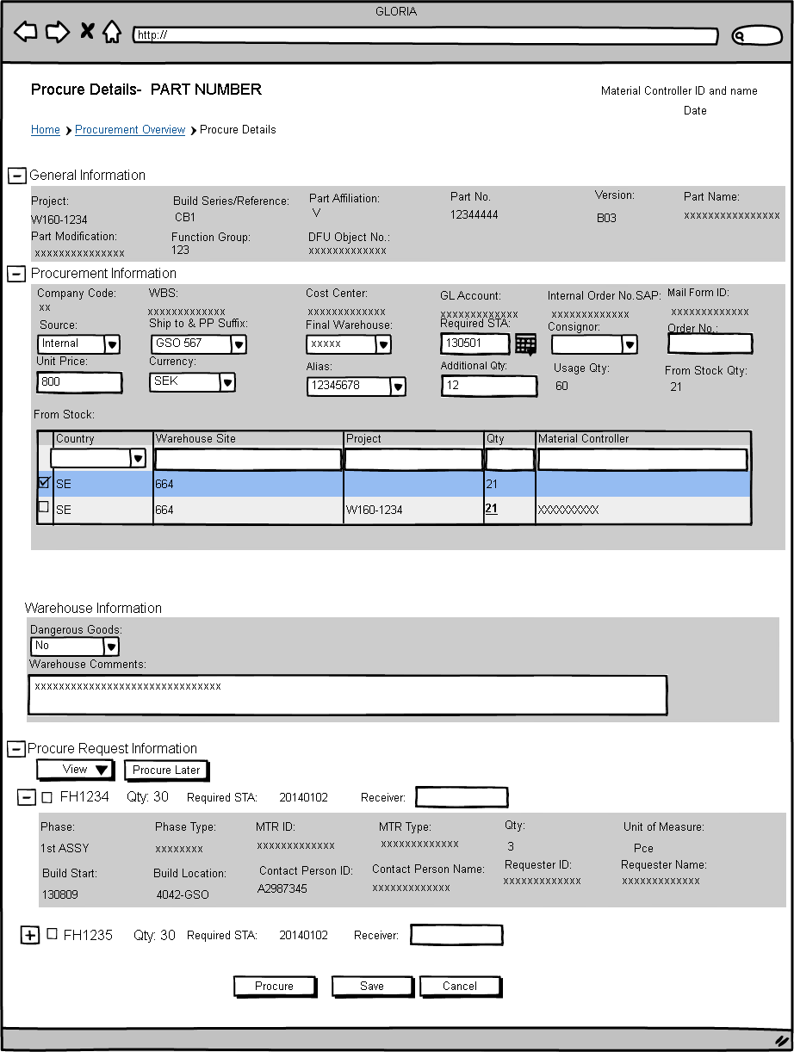

Slide 16
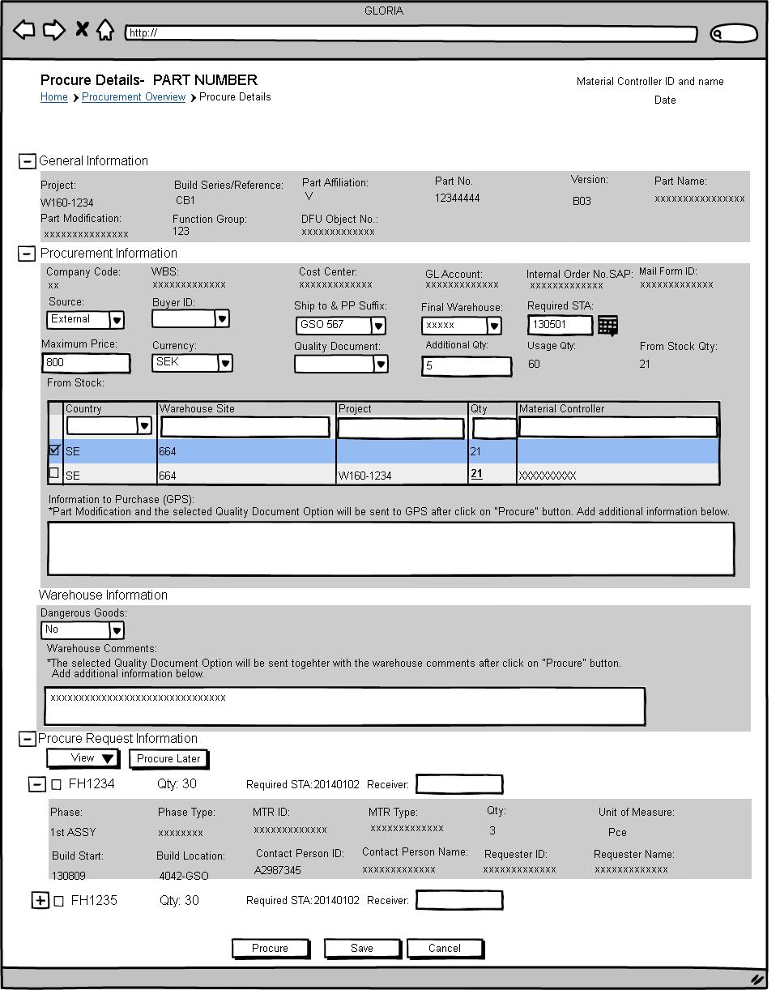

Slide 17
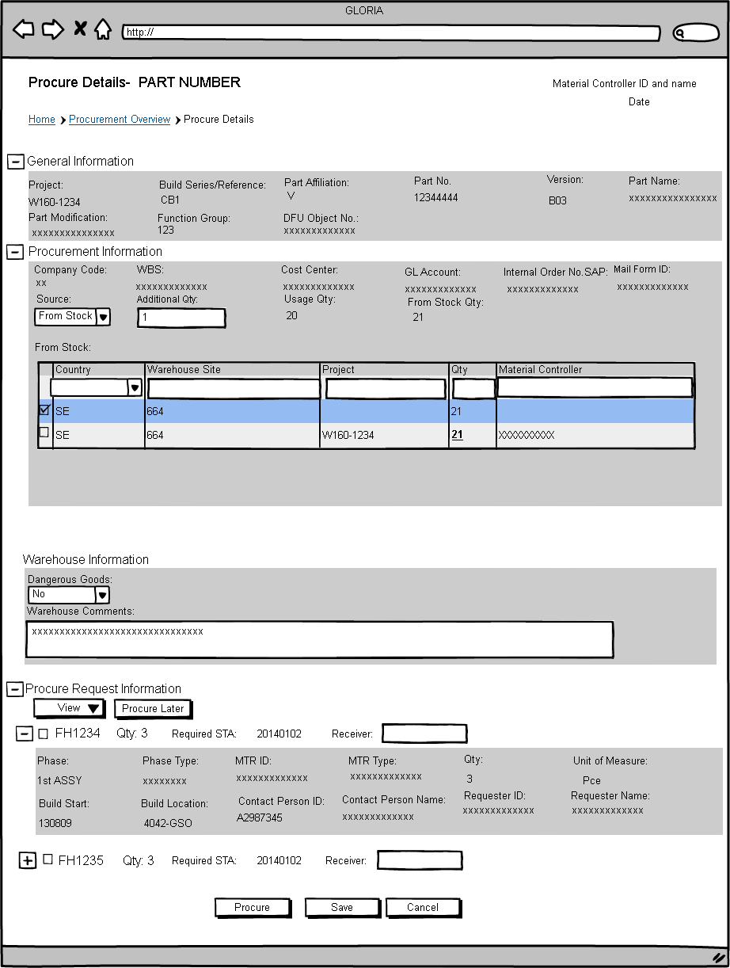

Slide 18
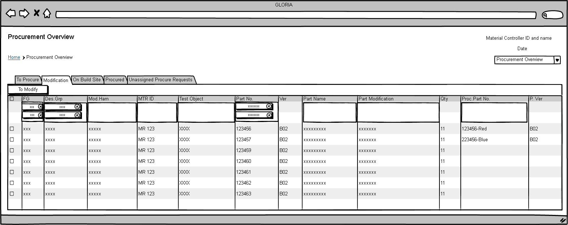

Slide 19
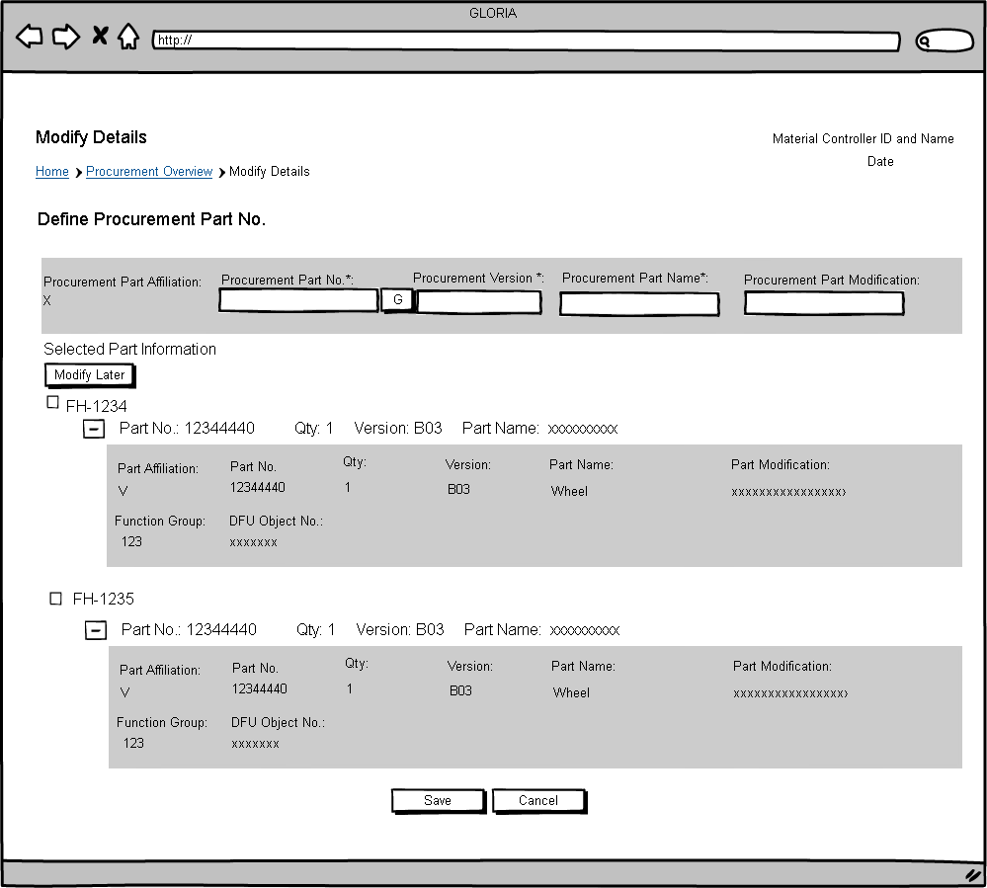

Slide 20
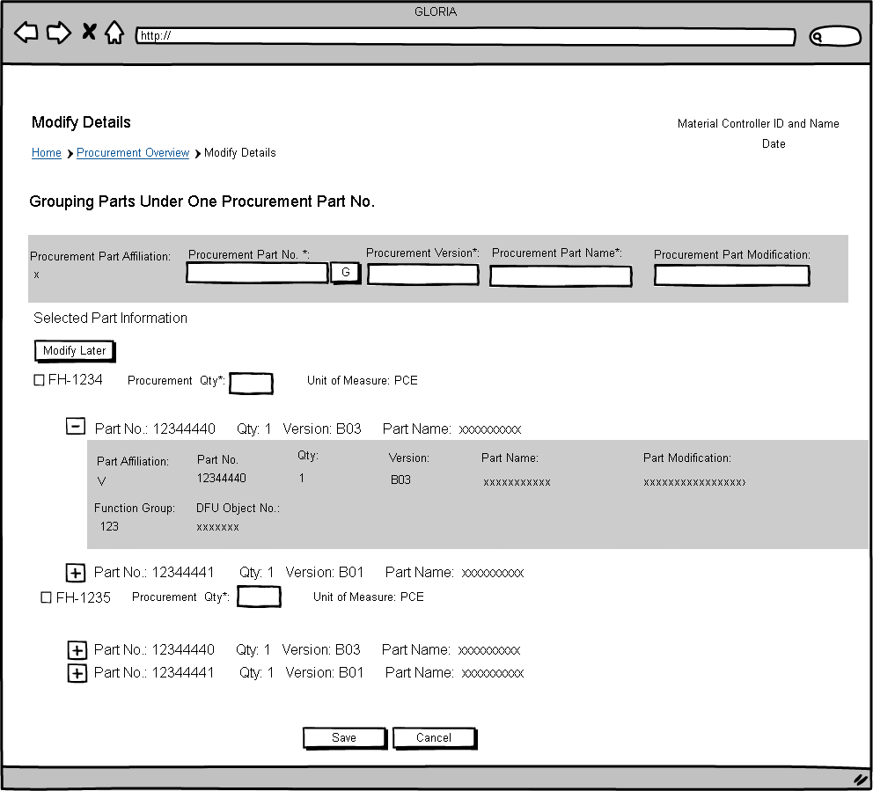

Slide 21
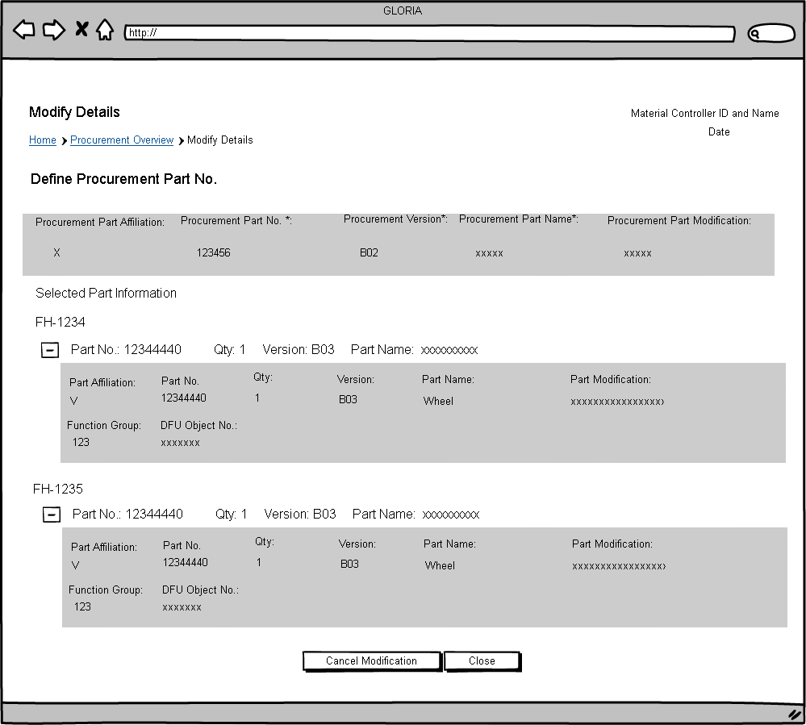
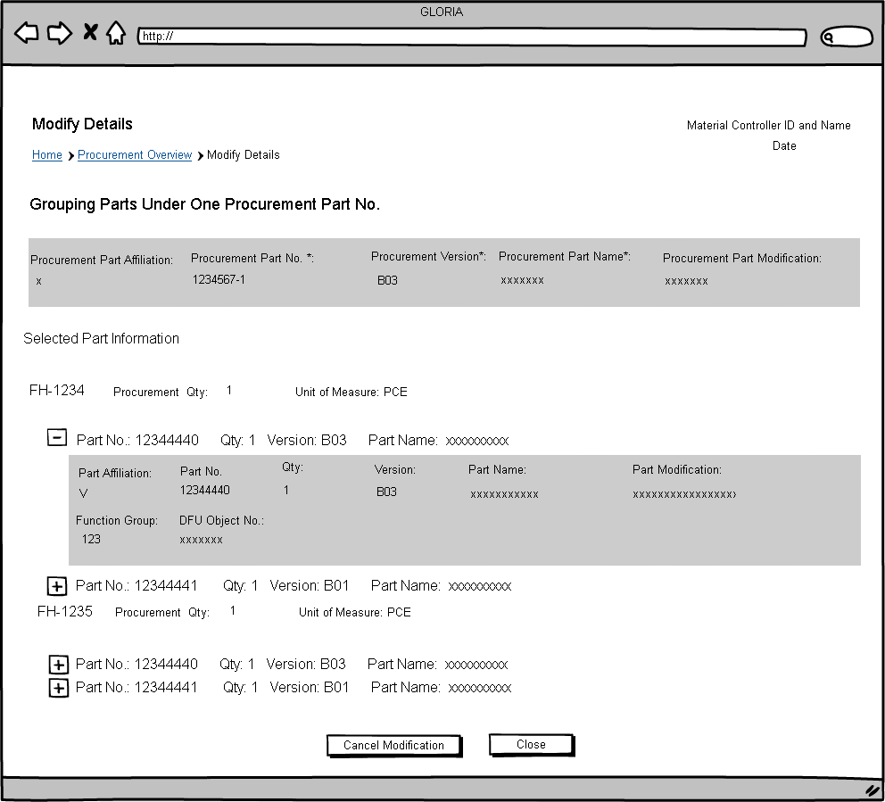

Slide 22
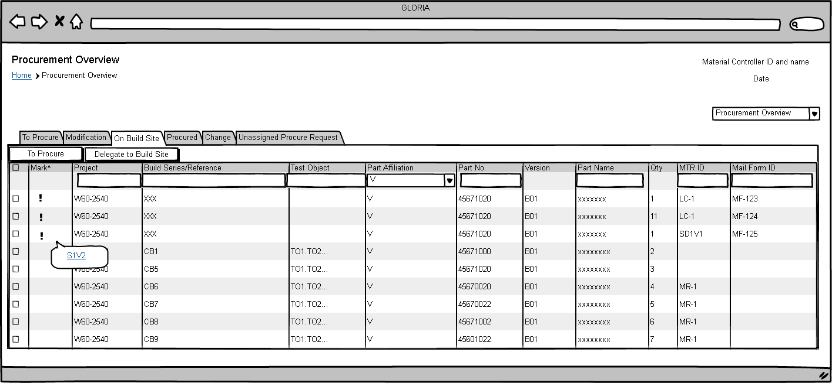

Slide 23
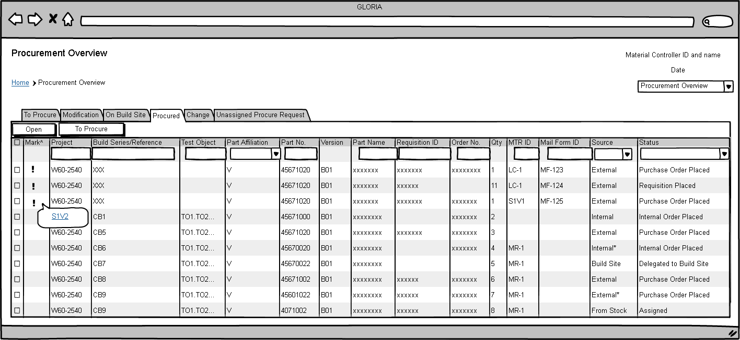

Slide 24
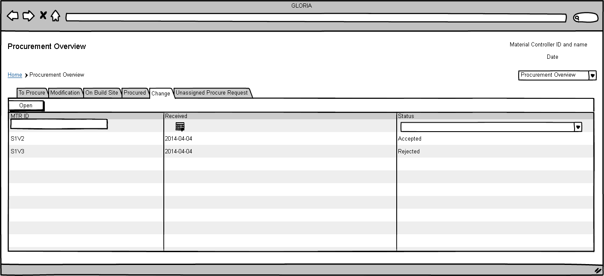

Slide 25
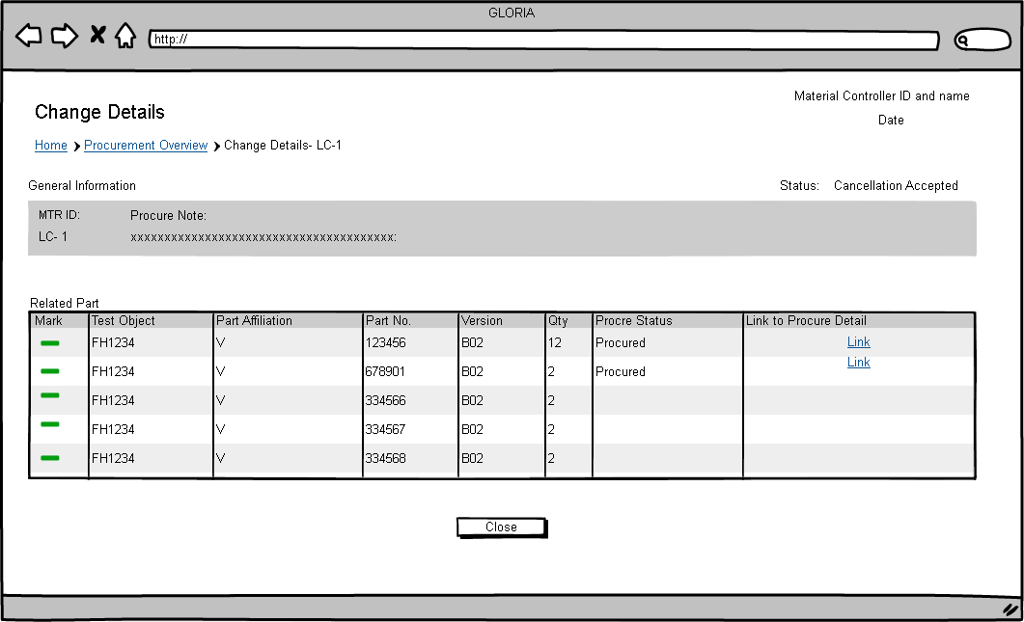

Slide 26
Material

Slide 27
Material Overview
Procurement
Material
Create Request List
Send Request
Warehouse

Slide 28
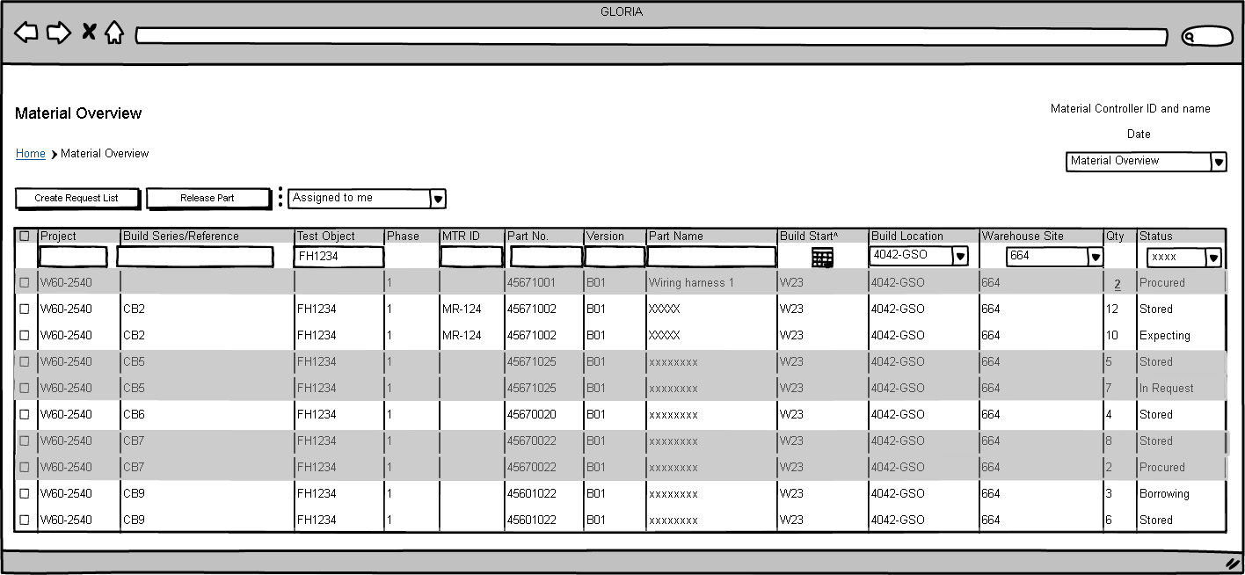

Slide 29
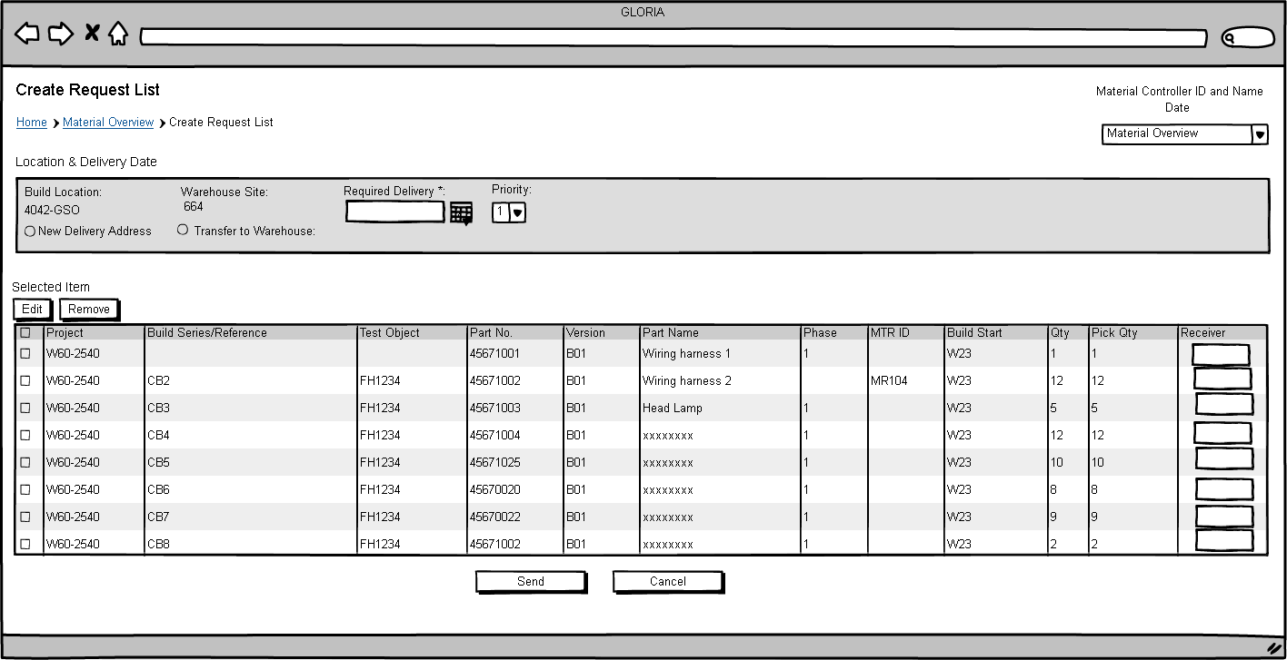

Slide 30
Delivery Control

Slide 31
Procurement
Delivery Control
My Order Overview
Warehouse

Slide 32
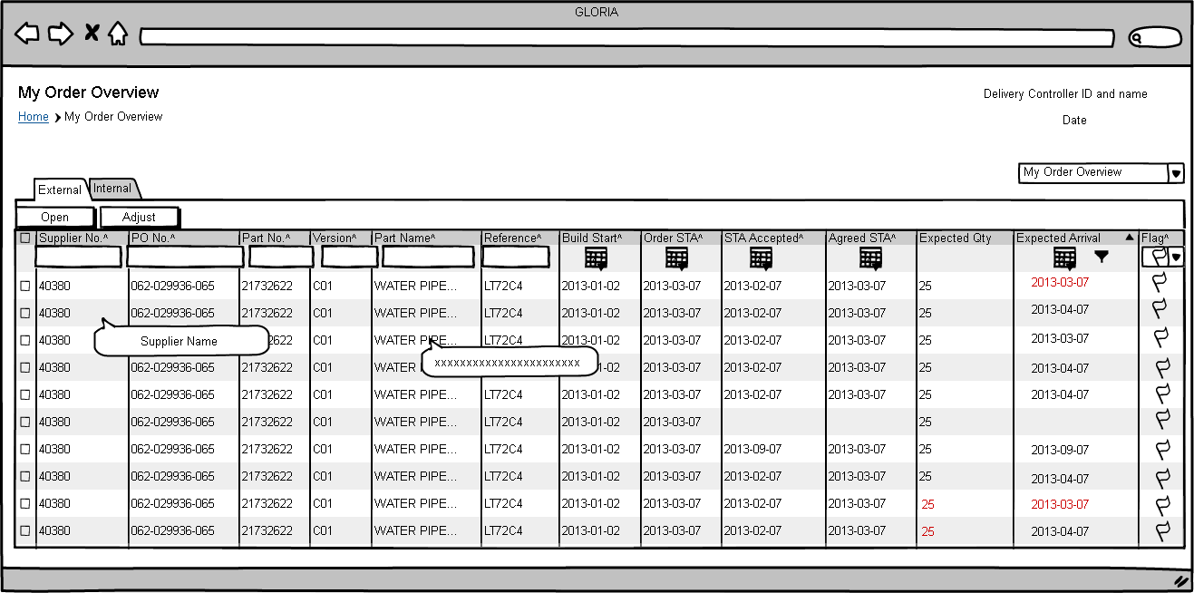

Slide 33
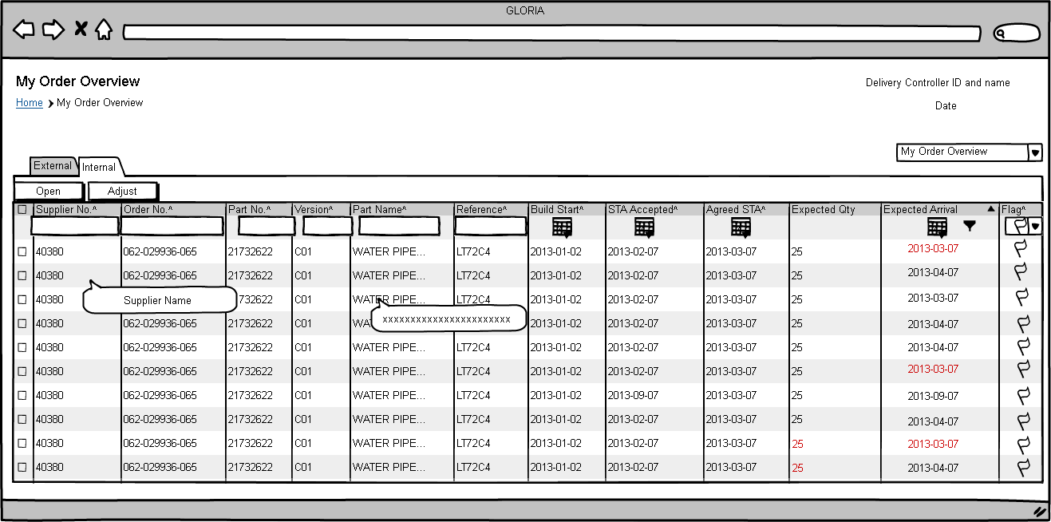

Slide 34
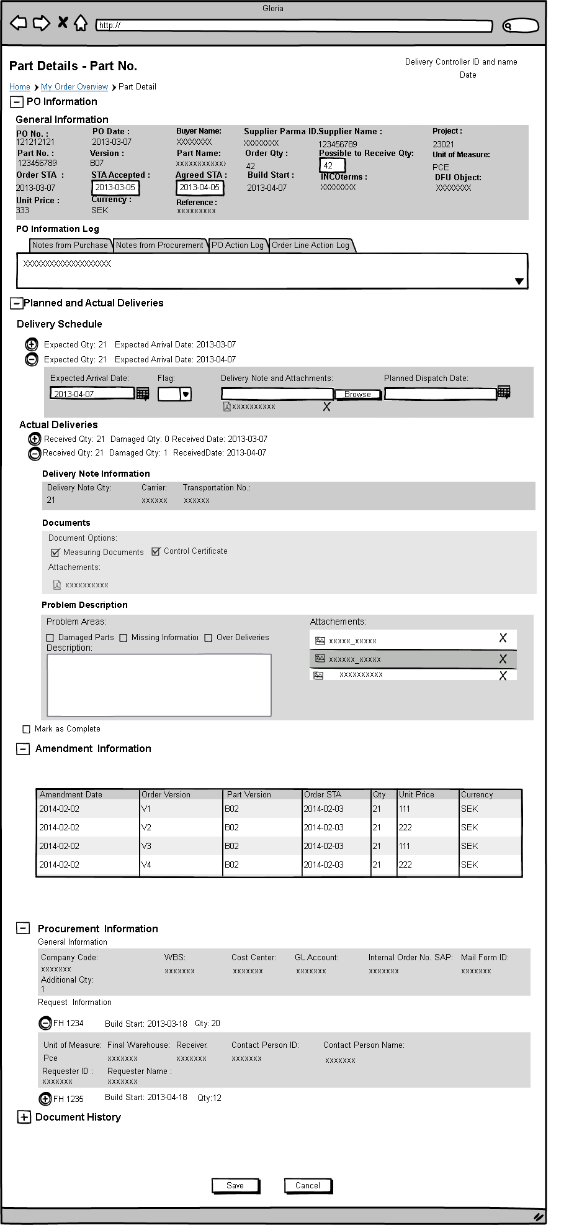
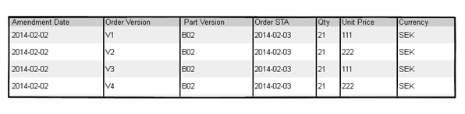
Prototype No.: PDH15V1

Slide 35
Warehouse Setup

Slide 36
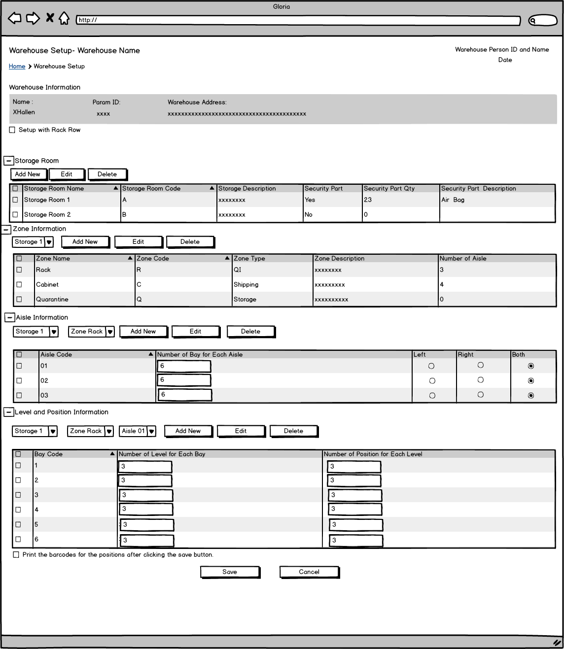

Slide 37
Warehouse

Slide 38
Receive
Store
Procurement
Delivery Control
Warehouse
Pick
Send Request
Ship
Material
Inventory

Slide 39
Receive

Slide 40
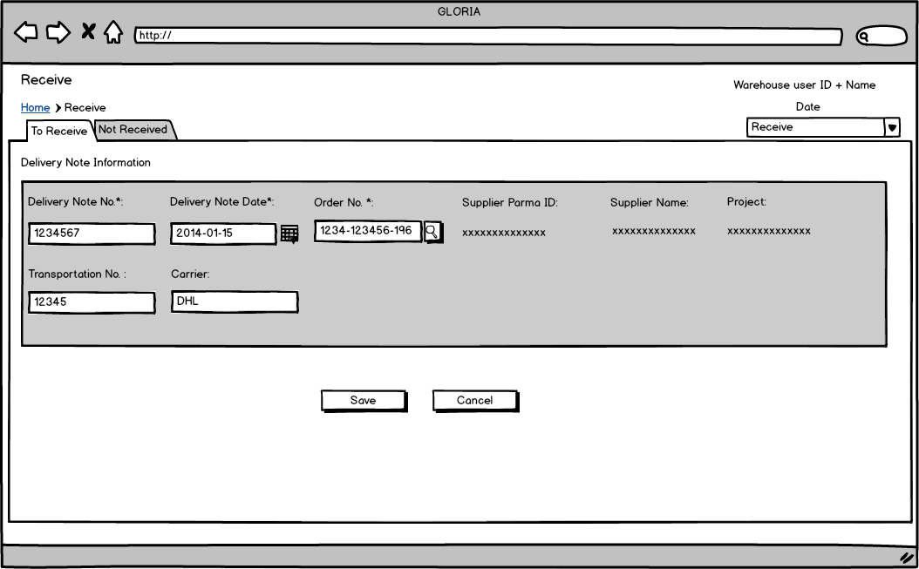

Slide 41
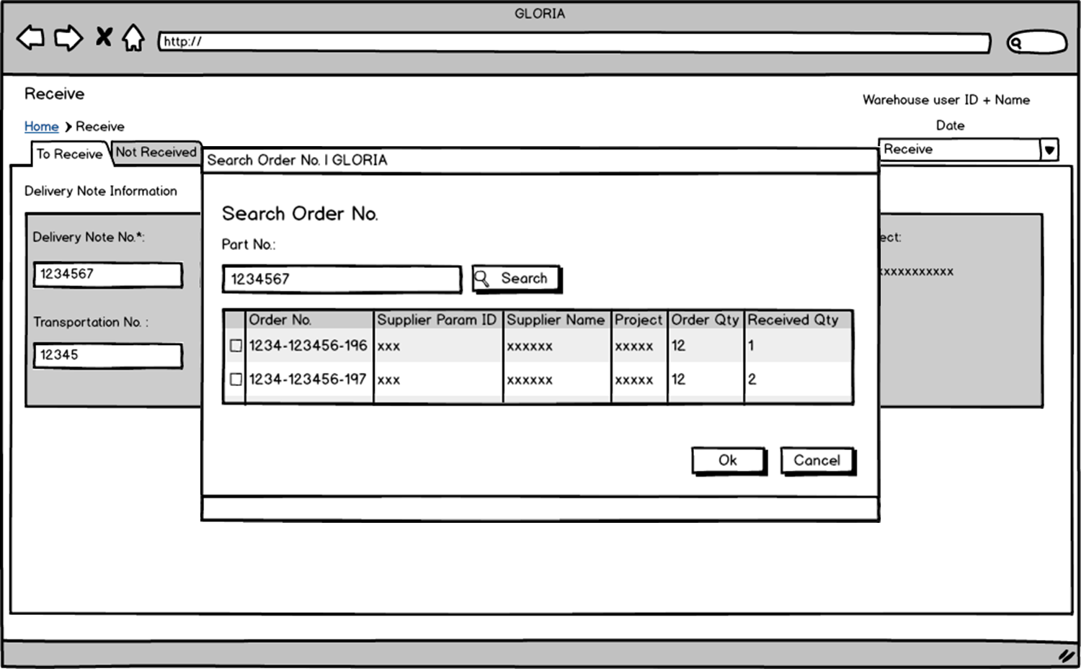

Slide 42
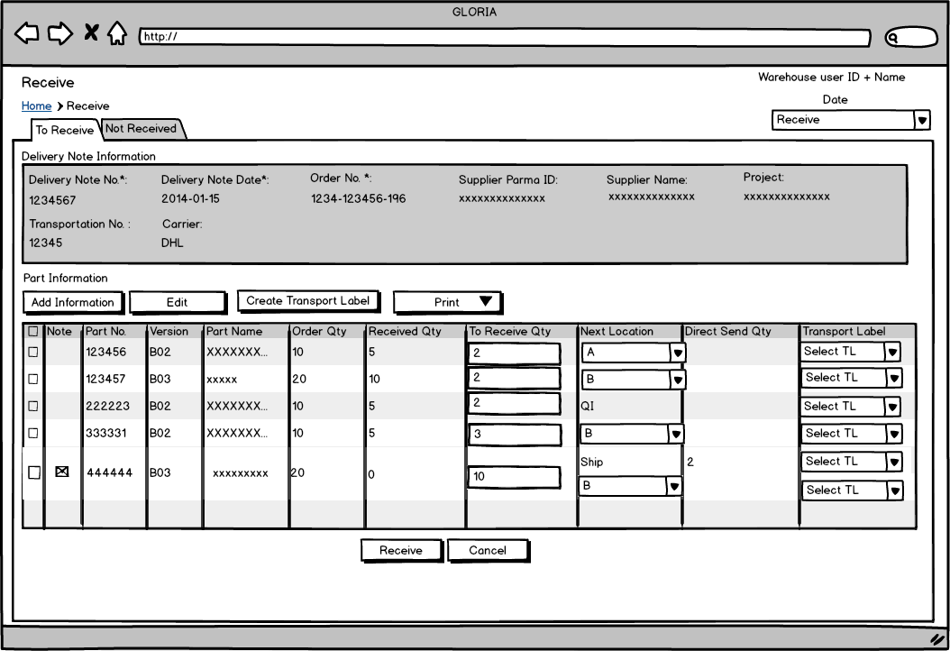

Slide 43
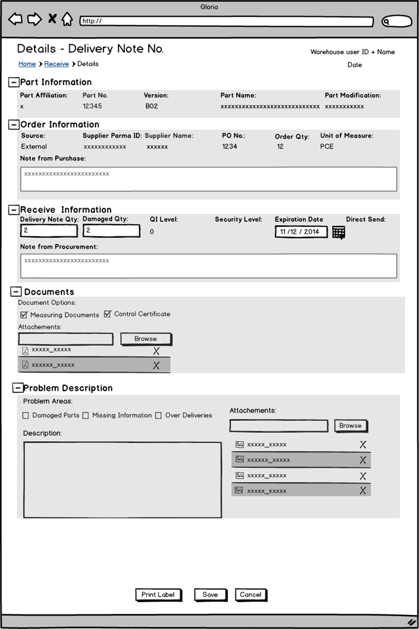

Slide 44
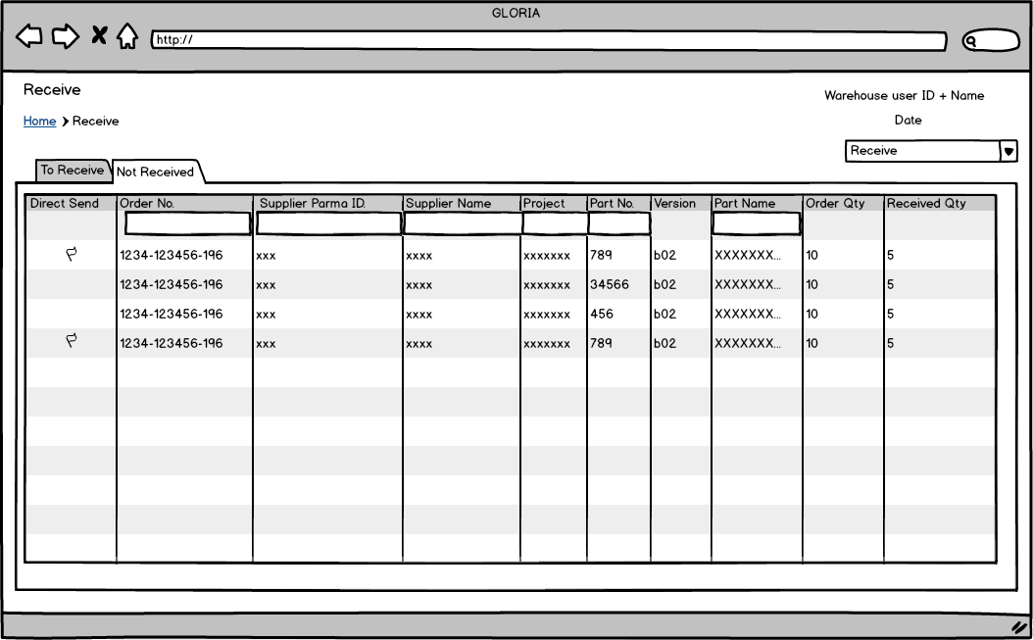

Slide 45
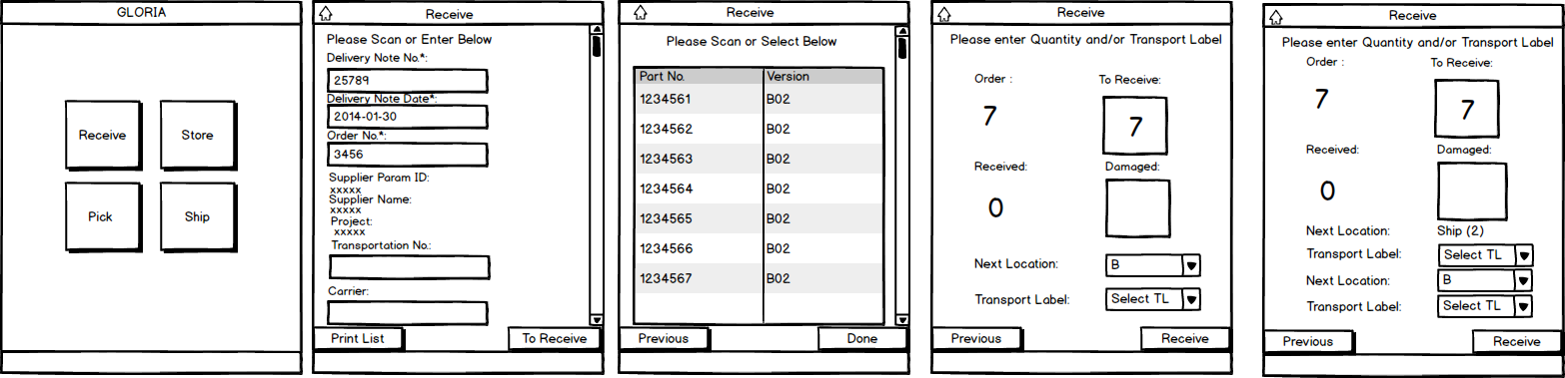

Slide 46
Store

Slide 47
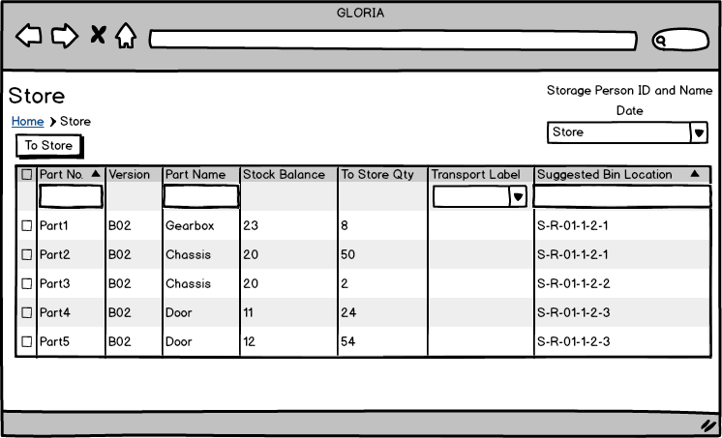

Slide 48
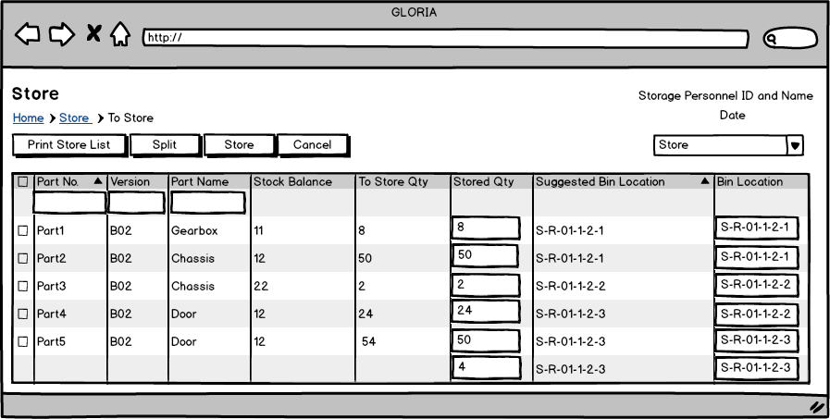

Slide 49
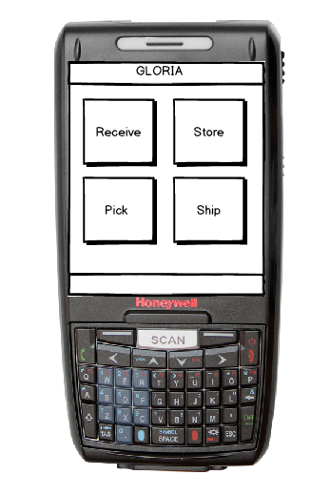
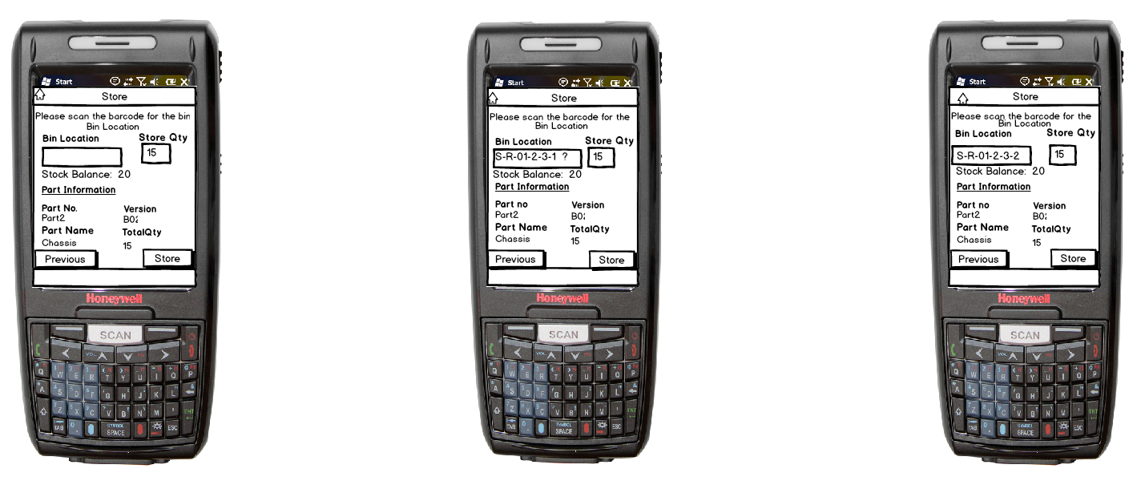
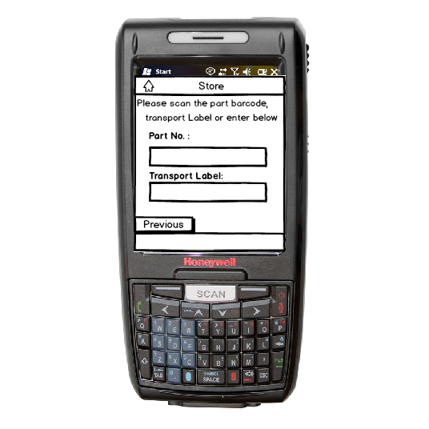
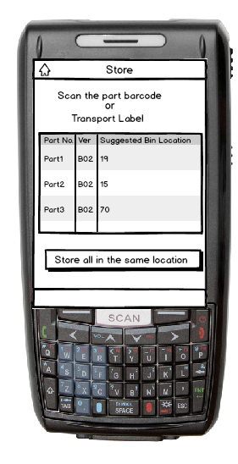
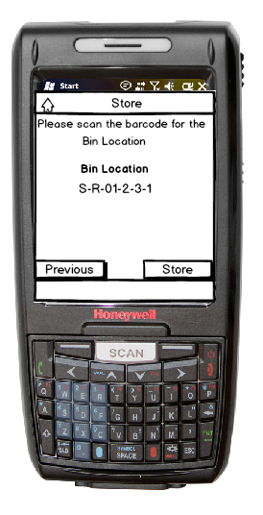
No Suggested bin location
Suggested bin location
After scan the bin location
3a
3b
3c
Save all in the same bin location
Button shall always visiable
1
2
Part No. Type and select
Scan or Select
4

Slide 50
Pick

Slide 51
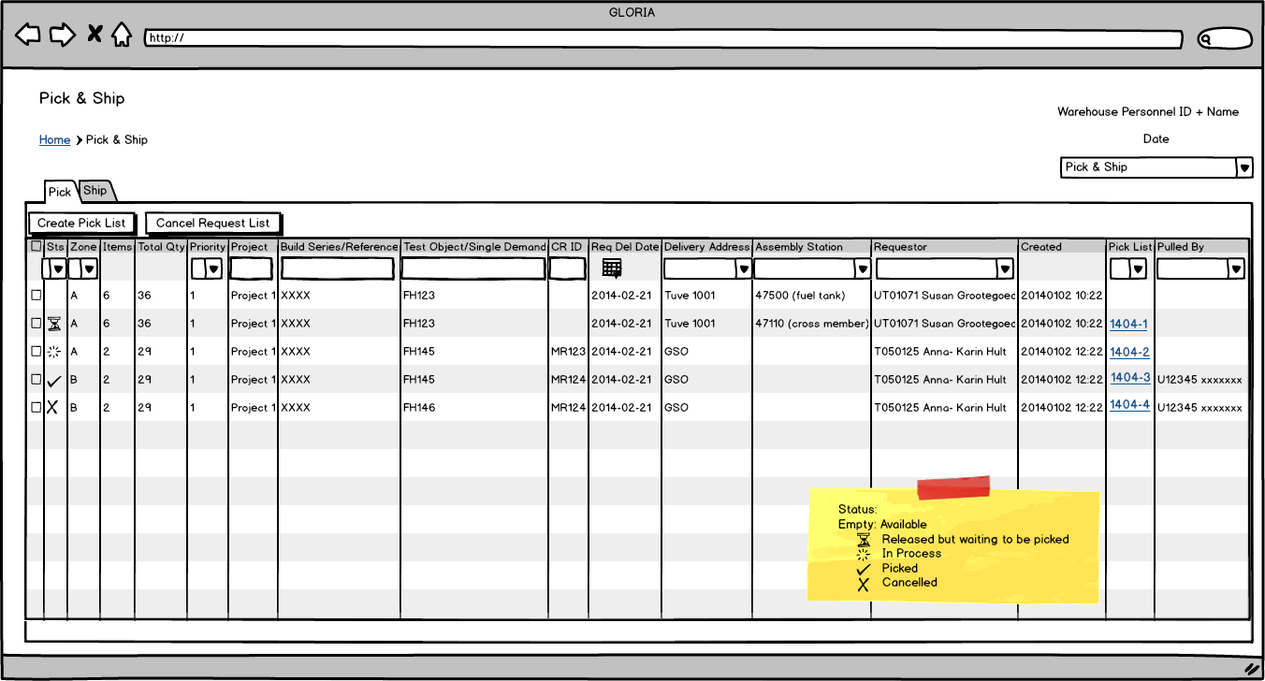

Slide 52
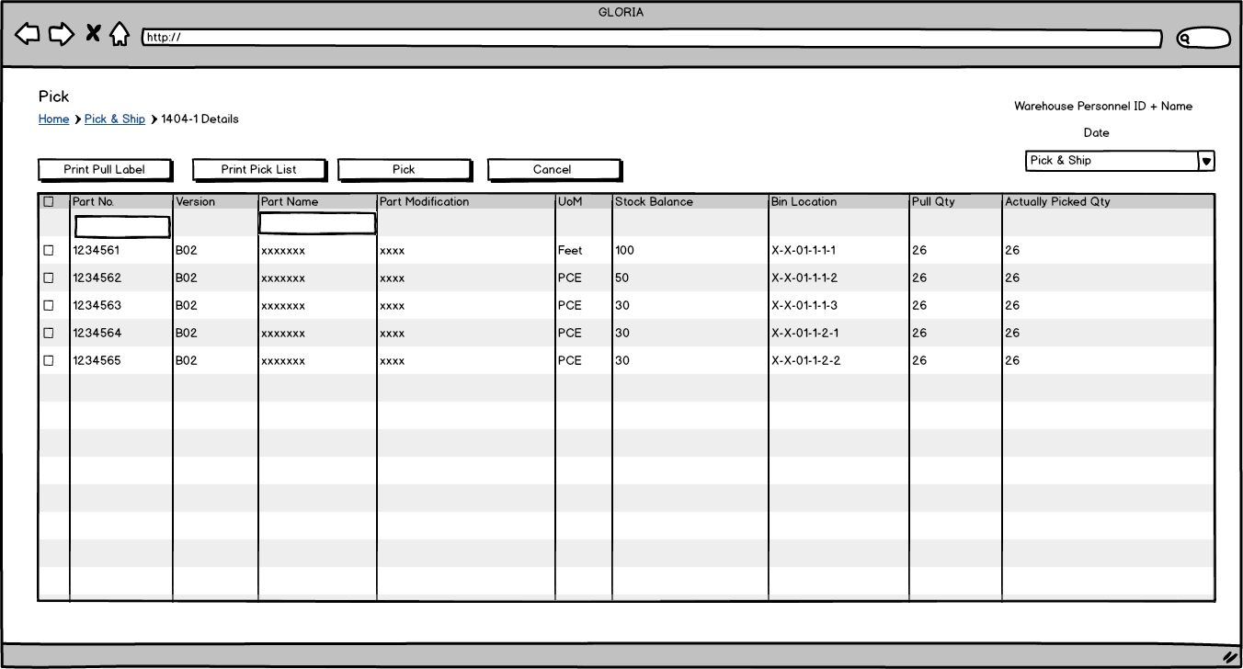

Slide 53
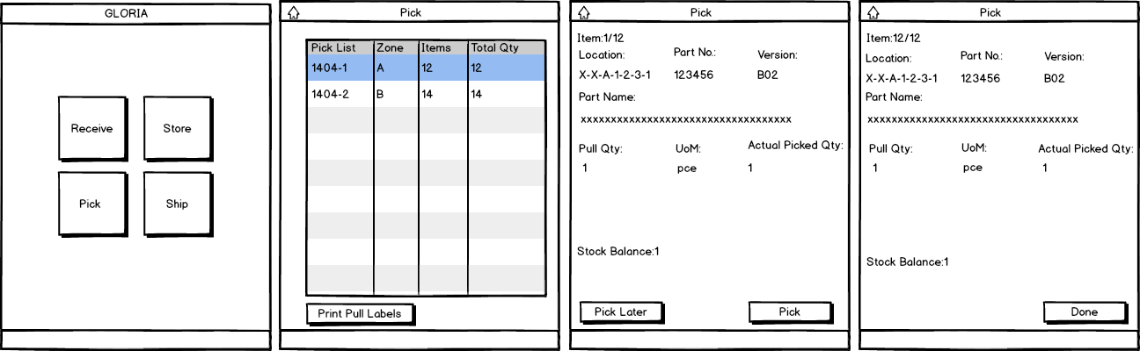

Slide 54
Ship

Slide 55
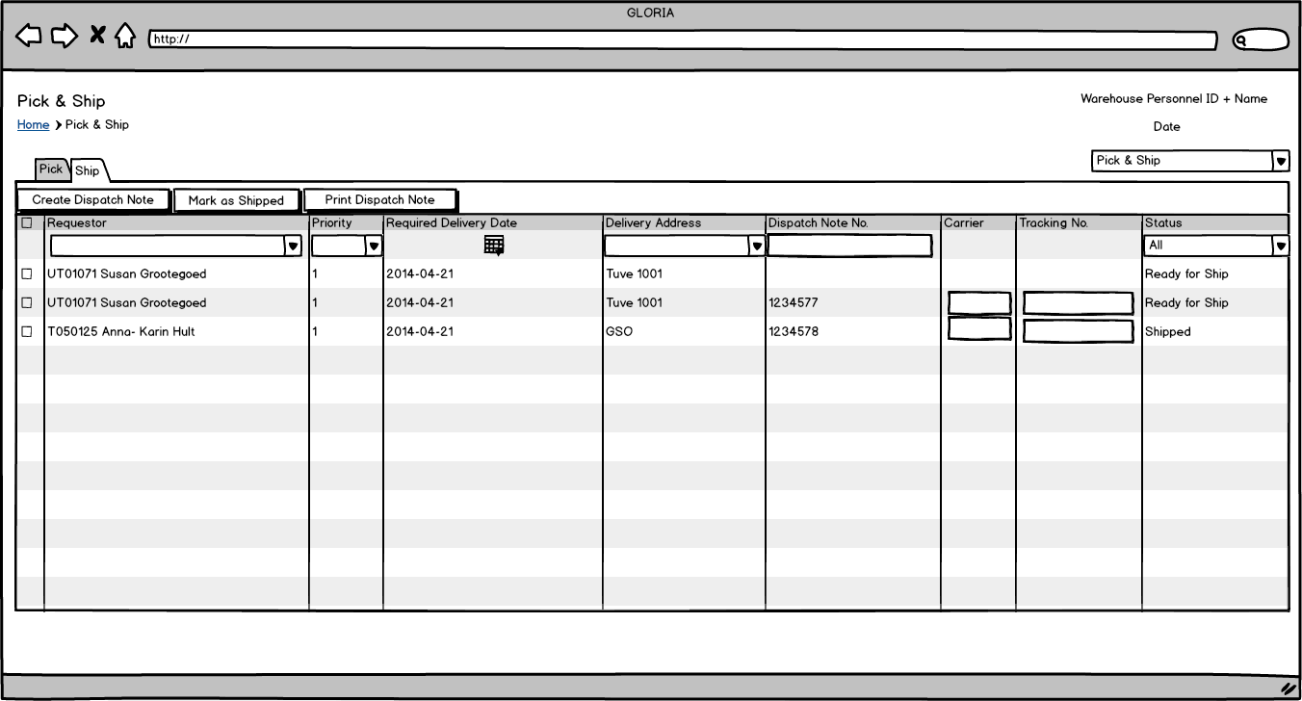

Slide 56
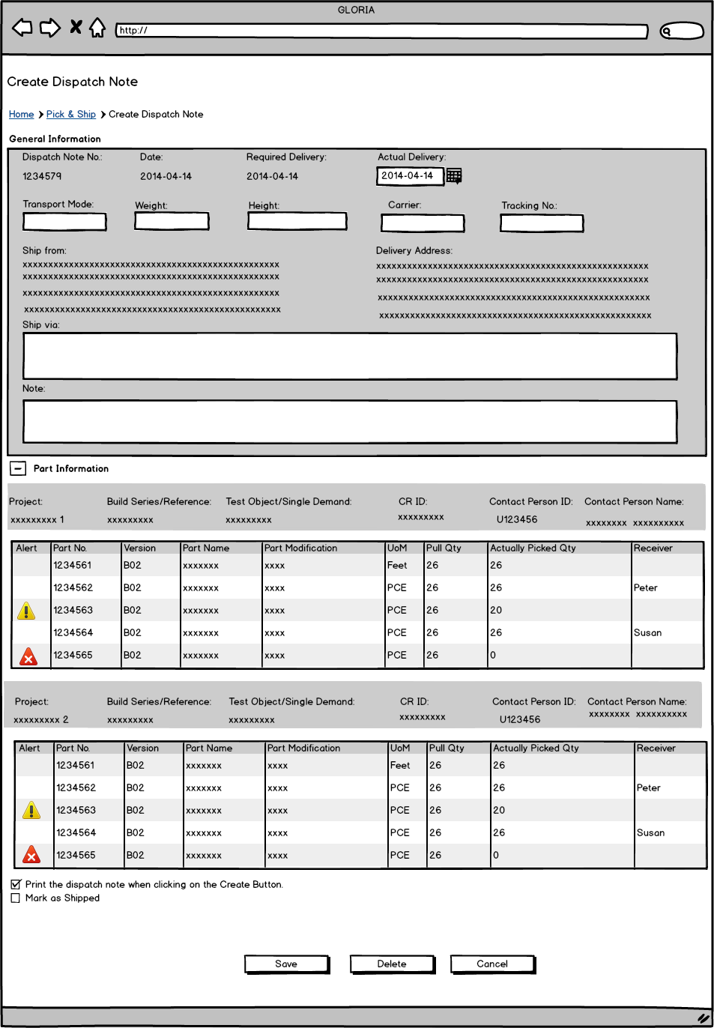

Slide 57
Inventory

Slide 58
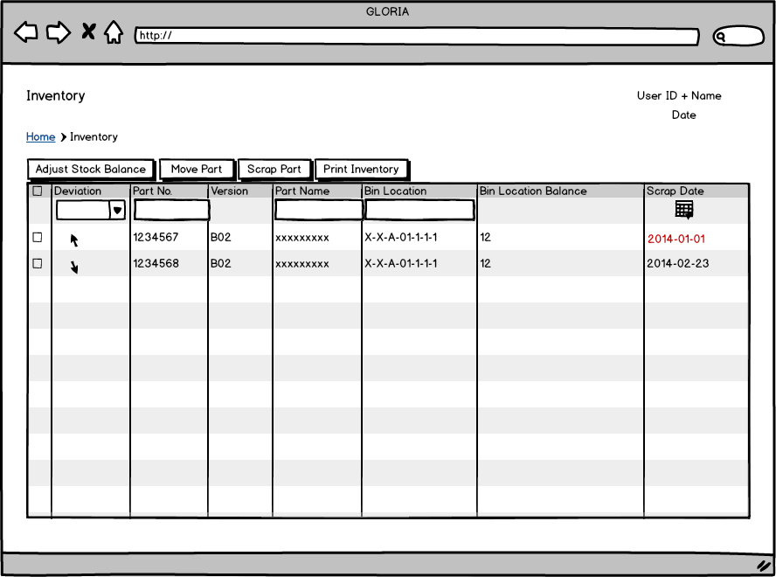

Slide 59
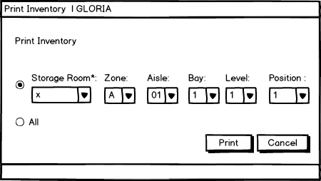

Slide 60
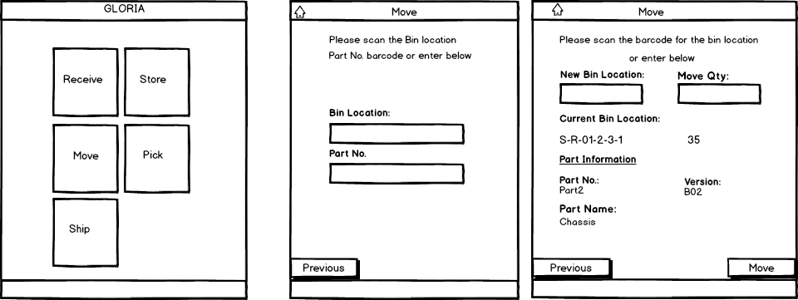

Slide 61
Quality Inspection

Slide 62
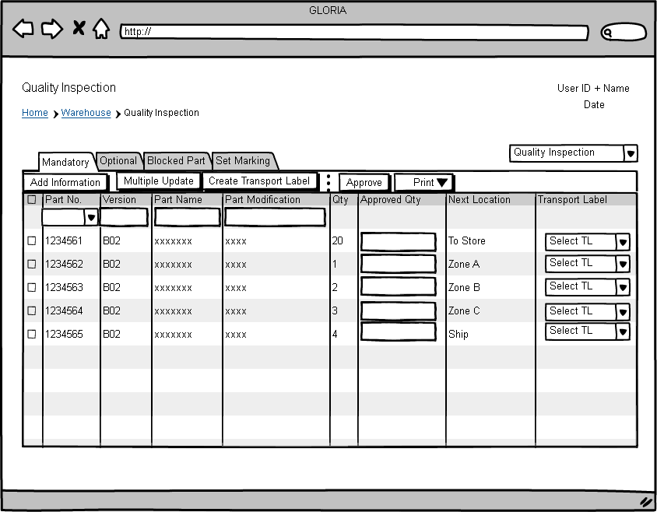

Slide 63
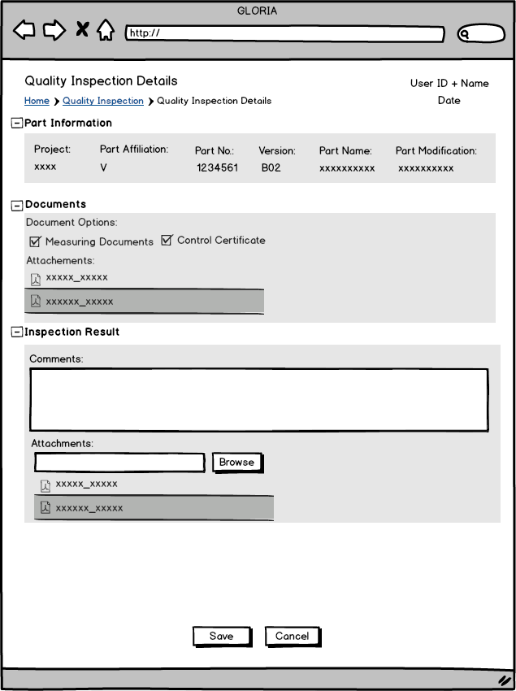

Slide 64
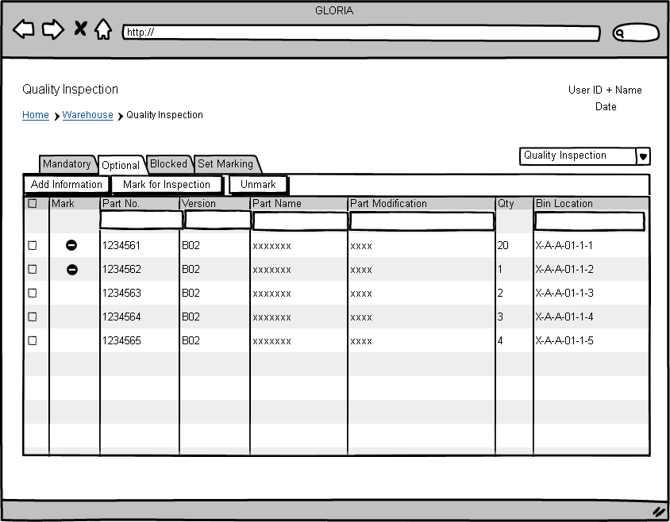

Slide 65
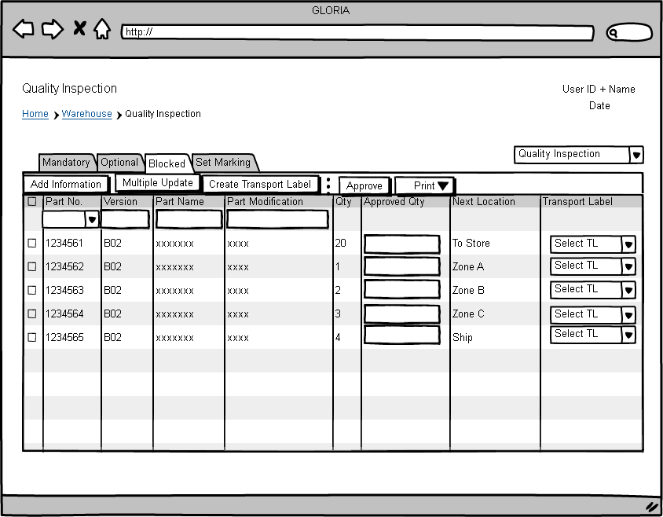

Slide 66


Slide 67


Slide 68


Slide 69


